Slide 1
LINQ to SQL LINQ to Entities
ORM Shootout
Howard Richards howard@conficient.com

Slide 2
LINQ to SQL LINQ to Entities
ORM Shootout
LINQ to SQL

Slide 3
What is LINQ to SQL?
Data provider for LINQ
History:
First LINQ provider - “kick the tyres”
Part of .NET 3.5 released 2008
Microsoft’s first ORM?
Future
“de-emphasised” not “dead”
Improvements and fixes in .NET 4.0
But.. EFv4 is the future

Slide 4
Why Should I use L2S?
Simple and easy to use
Very fast (low overhead)
Tools like LinqDataSource
Shared LINQ approach
Maturing
Free!

Slide 5
Why Shouldn’t I use L2S?
MS SQL Server only
Microsoft not developing further
Limitations in mapping
Not as powerful as Entity Framework
Toolset issues – see Huagati
Not open source
Limitations e.g. Batching, bulk updates

Slide 6
L2S and L2E compared
Comparator | LINQ to SQL | LINQ to Entities
Database | Microsoft SQL server only | SQL/Oracle/etc
Mapping | One-to-one with tables | Flexible mapping
Release status | Mature | EF v1 since Aug 2008 EF v4 in March 2010?
Future | “De-emphasised” | Microsoft Focus
Suitability | Smaller projects, SQL server only | Larger more complex projects
Third party support | Several tools available | Some tools available, more expected once stable
Performance | Fast | EFv1 slow.. EFv4 ???

Slide 7
How does it rate as an ORM?
Feature | LINQ to SQL | EF v4
Ease of development | Very good | Good?
Map classes to database objects | Basic mapping | Complex scenarios
POCO classes? | Yes | Yes (no in EFv1)
Avoid inline SQL | Good except for bulk operations | ?
Remove database/SQL dependencies | Poor – only SQL Server 200x | Good – support for SQL server, MySQL, Oracle and others
Performance | Very good | EFv1 slow.. no data for v4

Slide 8
How Does It Work?
DataContext
Partial classes
POCO
LINQ to query
LinqDataSource – ASP.NET
Demo ?

Slide 9
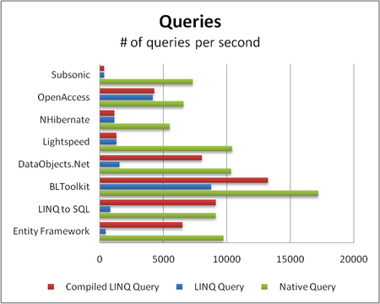
Performance
Source: ormbattle.net

Slide 10
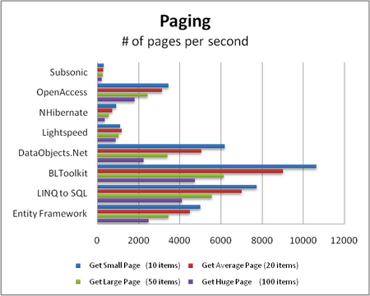
Performance
Source: ormbattle.net

Slide 11
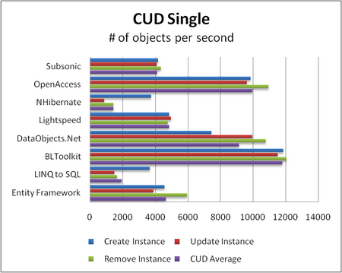
Performance
Source: ormbattle.net

Slide 12
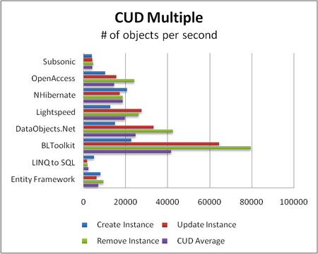
Performance
Source: ormbattle.net

