Slide 1
Ruby for .NET Developers
@andypike

Slide 2
Agenda
Introduction
Ruby
Getting Started
The Language
Ruby Gems
Rake
Rails
Getting Started
Demo – Building a bug tracker from scratch
Resources
Questions

Slide 3
Introduction
Why am I talking to you about Ruby?

Slide 4
Fish out of water

Slide 5
Take the red pill

Slide 6
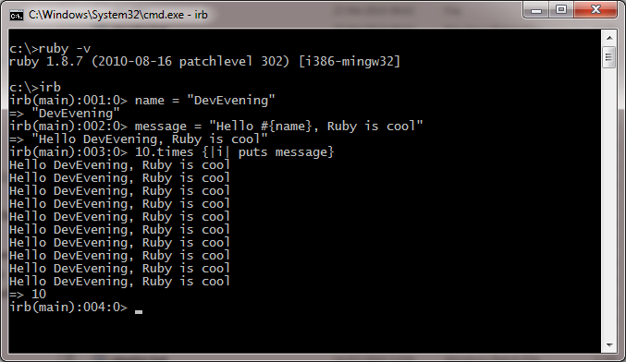
Warning
Command Line :o)

Slide 7
Ruby

Slide 8
About Ruby
Open Source OO Language
Created by Yukihiro "Matz" Matsumoto
Written in C
MRI (Matz Ruby Interpreter)
v1.0 released December 25, 1996
v1.9.2 released August 18, 2010
Other implementations exist
JRuby, MacRuby, IronRuby etc...

Slide 9
Getting Started - Installation
Download Ruby from ruby-lang.org
Ruby 1.8.7 RubyInstaller
Ruby 1.9.2 RubyInstaller
Check Ruby version
$ ruby –v

Slide 10
Getting Started - Tools
Most popular is TextMate on OSX - £43*
Some to try for Rails 3:
RubyMine 3 (beta) - £77 (£54pa upgrades)
Aptana Studio 3 (beta) - free
Programmers Notepad – free
Netbeans – free
Sublime Text - £37*
Vim – free (if you’re hardcore)
* Based on currency conversion at time of writing

Slide 11
Conventions
Variable scope
foo – local
@foo – instance variable
$foo – global variable
Foo or FOO – constant
Naming
methods_and_variables
ClassNames
Boolean return ends with ?
Dangerous methods end with !

Slide 12
String Concatenation
string name = “DevEvening”;
Console.WriteLine(string.Format(“Hello {0}!!”, name));
name = "DevEvening"
puts "Hello #{name}!!"

Slide 13
If’s
if(!isAdmin)
{
Console.WriteLine("You are not an administrator!");
}
if(!is_admin)
puts("You are not an administrator!")
end
if !admin?
puts "You are not an administrator!"
end
puts "You are not an administrator!" if !admin?
puts "You are not an administrator!" unless admin?

Slide 14
Loops
for(int n= 1; n <= 10; n++)
{
int square = n * n;
var s = string.Format("{0} x {0} = {1}", n, square);
}
1.upto 10 do | n |
square = n * n
s = "#{n} x #{n} = #{square}"
end
1.UpTo(10, n =>
{
int square = n * n;
var s = string.Format("{0} x {0} = {1}", n, square);
});

Slide 15
:symbols
Starts with a colon
You can create them adhoc
It’s a label (typically hash keys or enums)
It’s an instance (of class Symbol)
It’s like a string except there is only a single object per symbol name
:andy.object_id => 2625806
:andy.object_id => 2625806
“andy”.object_id => 537872172
“andy”.object_id => 537872152

Slide 16
Hashes
var options = new Dictionary<string, object>()
{
{ “mode”, FileMode.Append },
{ “filename”, “Andy.txt” }
};
options[“mode”] = FileMode.Create
options = { :mode => :append, :filename => “Andy.txt” }
options[:mode] = :create
#if a hash is the last param of a function, the curly brackets are optional
file_something :mode => :append, :filename => “Andy.txt”

Slide 17
Mixins
Ruby and C# are single inheritance

Slide 18
Mixins
I’ve got a great idea!
A flying car!
Your Boss

Slide 19
Mixins
Favour composition over inheritance
Mixins allow capabilities over type
module Airborne
def take_off
puts “I’m flying!”
end
end
class CarWithHoverConversion < Car
include Airborne
def start_engine
puts “Mr Fusion Started”
end
end
if vehicle.respond_to? :take_off
puts “This vehicle can fly!”
end

Slide 20
Dynamics
Redefining a method of a single instance
class Person
def talk
puts "Hello"
end
end
me = Person.new
me.talk => “Hello”
def me.talk
puts "Hi there!"
end
me.talk => “Hi there!”
you = Person.new
you.talk => “Hello”

Slide 21
Dynamics
Redefining and adding methods
class Person
def talk #redefining this
puts “This is cool"
end
def march #this is new
puts “Left, right, left, right...”
end
end
someone = Person.new
someone.talk => “This is cool”
you.talk => “This is cool”
me.talk => “Hi there!”
me.march => “Left, right, left, right...”

Slide 22
Dynamics
Mixin to existing classes (extension methods)
module Dancer
def throw_shapes
puts "Big fish, little fish, cardboard box..."
end
end
class Person
include Dancer
end
me.throw_shapes => "Big fish, little fish, cardboard box..."

Slide 23
Dynamics
Dealing with invalid method calls
me.send(:talk)
me.send("talk")
class Person
def method_missing(method)
puts "Sorry, I don't know how to #{method} :("
end
end
me.fly => “Sorry, I don't know how to fly :(”

Slide 24
Metaprogramming
At runtime, programmatically modify itself
COLOURS = {:black => "000", :red => "f00", :blue => “00f"}
class String
COLOURS.each do |colour, code|
define_method "in_#{colour}" do
"<span style=\"color: ##{code}\">#{self}</span>"
end
end
end
puts "Hello, World!".in_red
=> <span style="color: #f00">Hello, World!</span>

Slide 25
Ruby Gems
Package Manager for “Gems”
Allows distribution of programs and libraries
Similar to NuGet and OpenWrap
Mature: started in 2004, v1.0 released 2007
See rubygems.org for available gems
Commands:
$ gem list
$ gem install gem_name
$ gem uninstall gem_name
$ gem update gem_name
$ gem update --system

Slide 26
Rake
Software task manager DSL – your “assistant”
Text file named rakefile.rb with tasks:
Run via the command line:
Rails creates a rakefile with lots of useful tasks
Try Albacore (albacorebuild.net) for building .NET solutions with Rake
task :default => [:run_tests]
task :run_tests do
ruby “tests/run.rb”
end
$ rake
$ rake run_tests

Slide 27
Ruby on Rails 3

Slide 28
About Rails
Open Source Web Framework
Created by 37signals (extracted from basecamp)
Rails v1.0 released December 13, 2005
Rails v3.0 released August 29, 2010
Total Committers: 1692*
Rails 3 merged with Merb to end "unnecessary duplication“
Rails 3 separated out functionality into Modules to make them reusable outside of Rails
* Correct at time of writing

Slide 29
What is it?
Not just a web MVC
A very opinionated framework
Made up of:
ActiveRecord
Migrations
Generators
Routing
Validations
Console
Scaffolding
Bundler
More...
Lots of gems for high productivity

Slide 30
Getting Started
Update RubyGems (1.3.6+)
$ gem update --system
Install Rails
$ gem install rails
Create your first app
$ rails new MY_APP_NAME
Common Rails commands
$ rails s[erver]
$ rails g[enerate]
$ rails c[onsole]

Slide 31
Rails Bug Tracker
Demo time
How to build a simple bug tracker

Slide 32
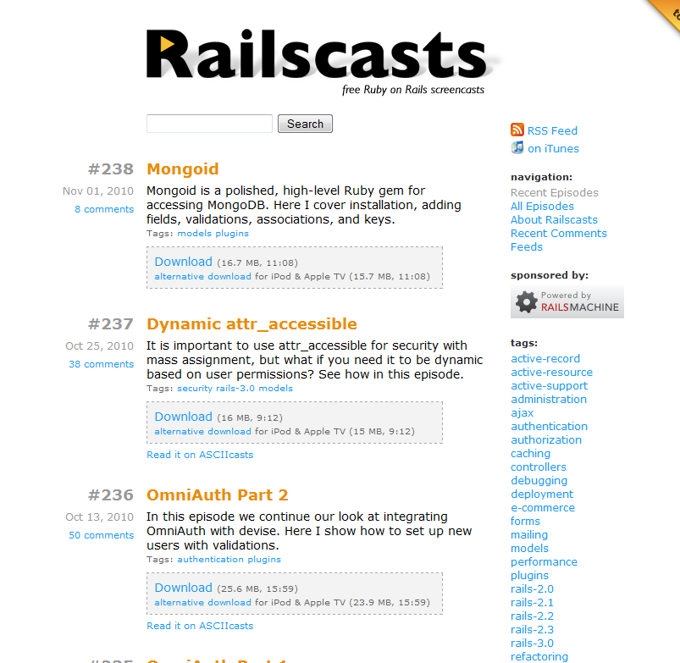
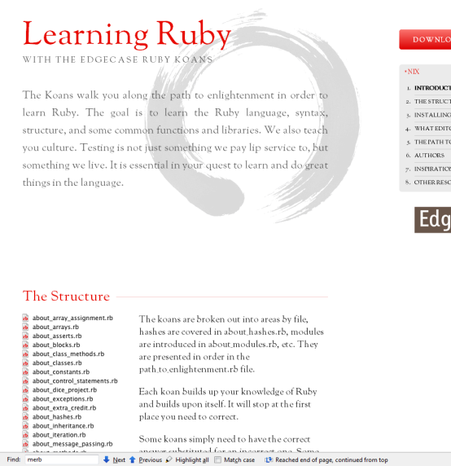
Resources - Sites
ruby-lang.org | The Ruby language
rubyonrails.com | The web framework
railscasts.com | Free screencasts
ruby-toolbox.com | Lists gems by category and popularity
railswizard.org | Create rails app and template (RailsRumble)
rubygems.org | Gem hosting
github.com/rails | Rails source code
rubykoans.com | Learn Ruby through tests (red/green/refactor)

Slide 33
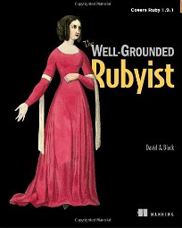
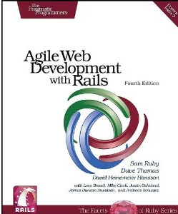
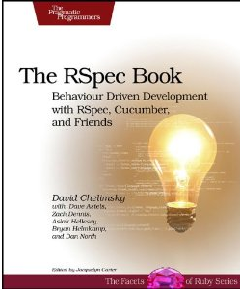
Resources - Books
The Well-Grounded Rubyist
Agile Web Development with Rails (pre-order)
The RSpec Book (beta ebook)

Slide 34
Questions?
Go easy on me ;o)
RubyMine licence for the best question
Thanks JetBrains!
Twitter: @andypike
Feedback: speakerrate.com/andypike

